Slide 1
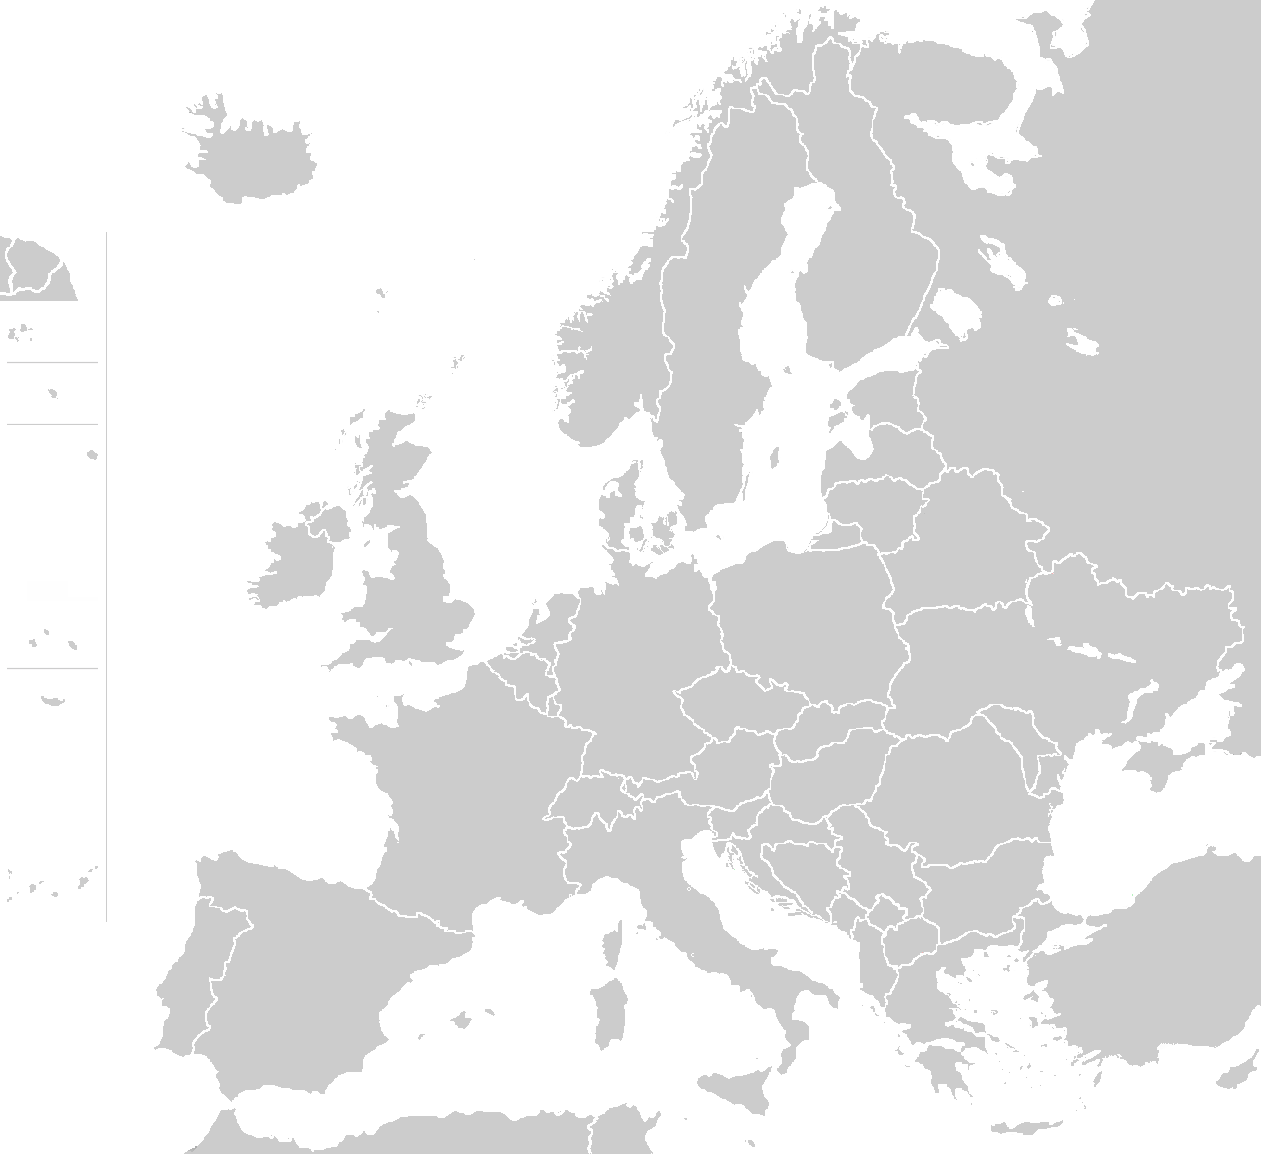


EXPLORE EUROPE!
WANT TO GAIN VOCATIONAL SKILLS FROM YOUR SCHOOL’S PARTNER COUNTRY IN EUROPE?
APPLY NOW FOR A 4 WEEK LONG MOBILITY IN .............!

